Slide 1
BOREWELL RESCUE BOT
(CTF PROJECT)
PROJECT MEMBERS :-
1. VIGNESHWARAN.E (2018111130)
2. DEVA ANANDHAN. AS (2018104016)
3. HARIHARAN. V (2018111042)
4. RAJADURAI. B (2018111086)
5. PRAVEEN
6. FREDRICH

Slide 2
OBJECTIVE :-
To rescue the child fallen into the borewell.
It is safer than conventional methods.
It is more cost effective.
It is suitable for almost any kind of borewells.
The required to rescue the child is less than conventional methods
The injuries the child may suffer when rescuing from the borewell will be reduced.

Slide 3
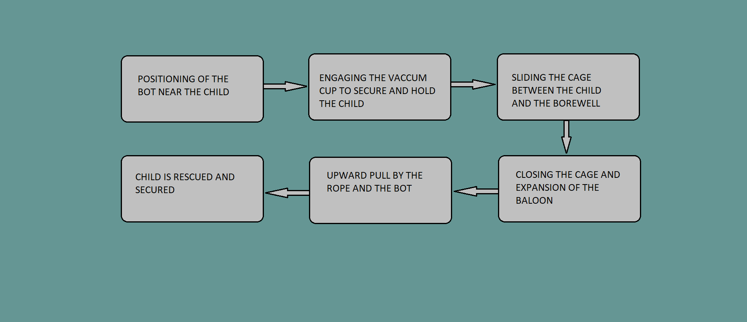
BLOCK DIAGRAM :-

Slide 4
OVERALL VIEW :-
Almost 30 cases of children who died due to open borewell is recorded in tamilnadu and we don’t have any reliable techniques or mechanism to rescue the child
Our projects aim is to rescue the child as safely as possible and to make a bot which would rescue the child fallen into any kind of borewell with any size.

Slide 5
BUDGET :-
1.) Bot drive mechanism and motors - 6000
2.) Hydraulic arm and mechanism - 5000
3.) Child cage structure - 5000
4.) Sensors and controllers - 5000
5.) Fpv camera - 6000
6.) Compressor and balloon - 6000
Mechanism
7.) Suction cup mechanism - 6000
8.) Bot chassis - 3000
9.) Extras - 8000
TOTAL - 50,000

Slide 6
Thank you

